Slide 1



Patient Involvement in Translational Research - the example of Patient Engagement Resource Centre for Translational Researchers of EATRIS Plus Project
November 2023
Elena Balestra Head of Membership and Capacity
Building at EPF

Slide 2
PANELISTS
Anca Toma
Executive Director, EPF
Eliis Keidong
EATRIS Member Engagement Officer
Giorgio Barbareschi
Santa Rasa-Dzelzkaleja
Leading Researcher
Riga Stradiņš University
David Velasco
Programme Manager European AIDS Treatment Group
Health Institute Carlos III, Madrid

Slide 3

AGENDA
14:00-14:05 – Welcome, housekeeping rules and
panelists’ introduction
14:05-14:15 – Introduction to the project and live demo on PERC, Eliis Keidong (EATRIS)
14:15-14:45 – Panel discussion
Anca Toma (EPF), Santa Rasa-Dzelzkalē (RSU), Giorgio Barbareschi (EATG), David Velasco (Health Institute Carlos III, Madrid)
14:45-14:55 – Q&A*
14:55-15:00 – Closing remarks

Slide 4
Housekeeping rules
Productive and respectful online collaboration
Use headset/earphones
Use chat box in case of technical issues
Please use the Q&A chat or raise your hand if you would like to take the floor and ask a question

Slide 5


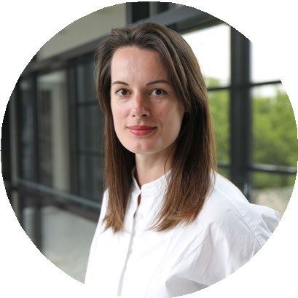
EATRIS driving Patient Engagement in Academic Research
Eliis Keidong | EATRIS Member Engagement Officer

Slide 6
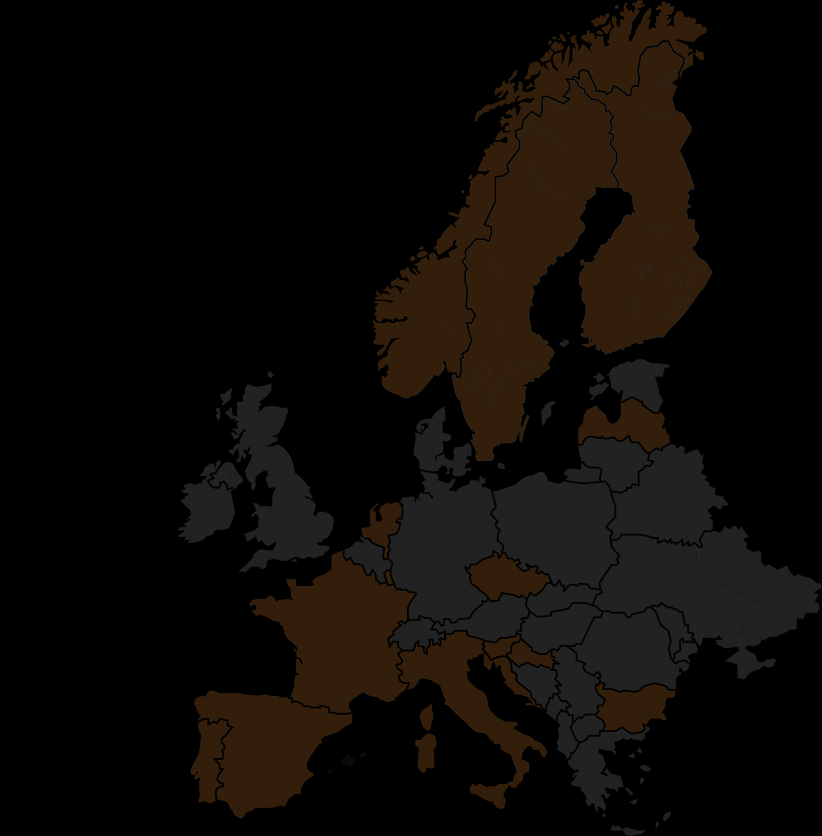




Who is EATRIS
The European Research Infrastructure for Translational Medicine
150+
Research Institutes
5 Scientific Platforms
ATMPs
Biomarker
Imaging & Tracing
Small Molecules
Vaccine, inflammation and immune monitoring
14
countries
Legal status
Non-profit, ERIC legal status
EATRIS strives for a healthier future by transforming scientific breakthroughs into medical advancements for patients and society
2

Slide 7


Our mission
To accelerate the translation of research discoveries into patient benefit.
Using our capacities and expertise we support
academia,
industry,
patients
policy makers
Industry
Regulators
Academia
Clinicians
Patients
3

Slide 8







EATRIS commitment to accelerate patient engagement in academic research
Visit our dedicated webpage: https://eatris.eu/patient-engagement-2/
4

Slide 9

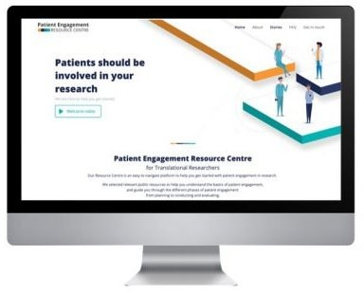
EATRIS-Plus Project
One of four key objectives → To drive patient empowerment through active involvement in the research process
1
Formation of the Patient Advisory Committee
7 members with diverse expertise in Advocacy, Communications, Education, and Scientific Advice
Coordinated by EATG
consult and advise EATRIS and EATRIS-Plus project from the patient perspective
2
Development of Patient Engagement Resource Centre
5

Slide 10









Jan – Feb 2023
New round of focus group meetings for feedback on pilot platform
February 2022
Kick-off the task force composed of patient representatives and academic staff
July – December 2022
Development of the platform content & further consultation through PEOF event
1
2
3
4
5
March – June 2022
Consultations through focus groups and Patient Engagement Open Forum (PEOF) event
March 28th 2023
Launch of the PERC
Visit: patient-engagement.eu
6

Slide 11


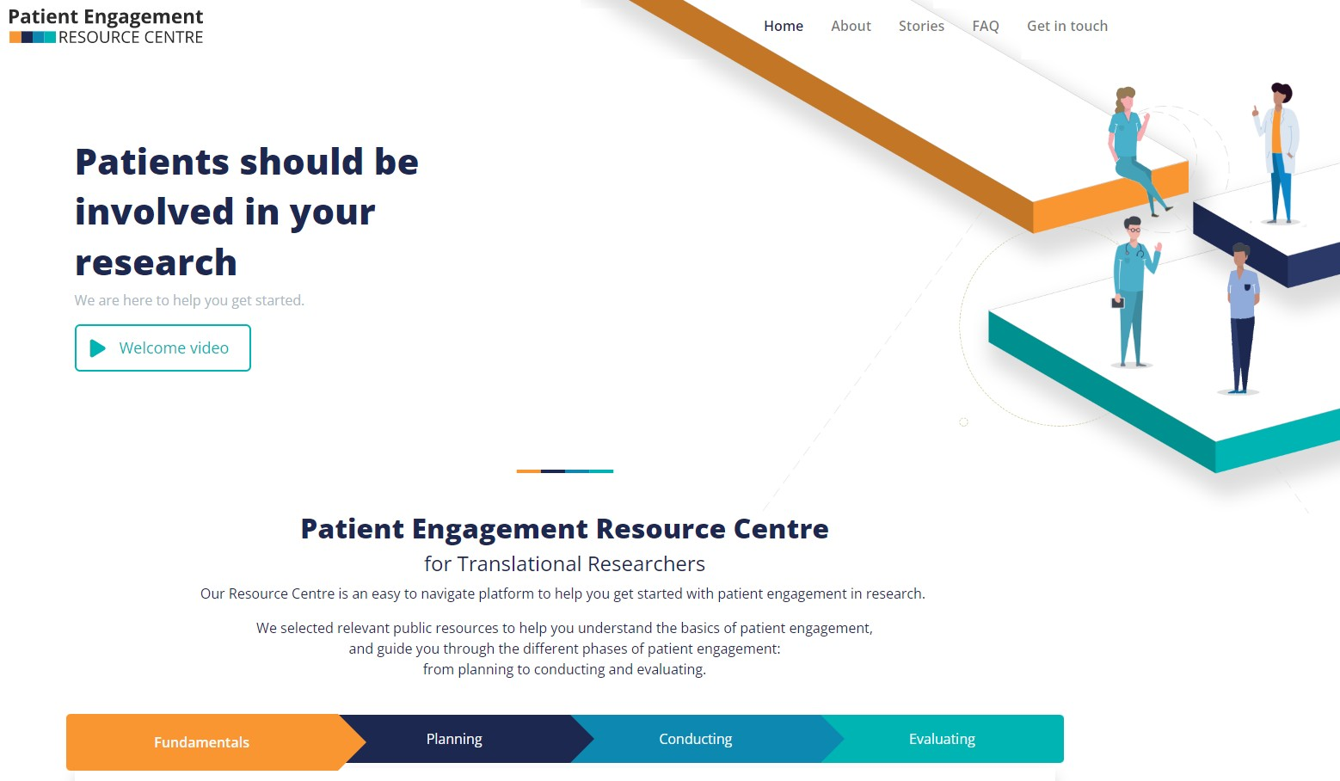





Find out more on
patient-engagement.eu

Slide 12


Get involved!
Ask a question
Submit a resource
Help us disseminate the platform
Suggest a story
Visit: patient-engagement.eu
8

Slide 13
Question One
How the PERC was developed and how were the patients involved? What are the key learnings of the process?

Slide 14
Question Two
How do you think patient organizations can contribute to the promotion of the PERC?

Slide 15
Question Three
We are aware that you are leading patient engagement pilot in the context of the EATRIS Plus project. What are the main challenges and learnings so far?

Slide 16




EATRIS-Plus patient engagement Latvia node event
Santa Rasa-Dzelzkalēja Leading Researcher RSU
WP5 – Stakeholder Engagement
WP8 – International Collaboration
15.11.2023

Slide 17
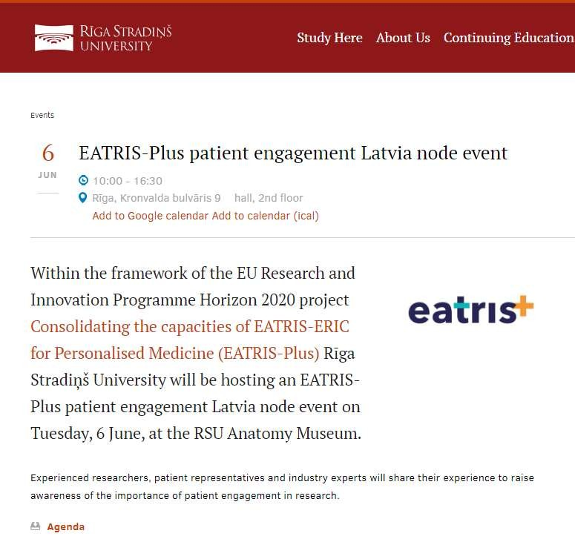

Slide 18

PERC
Understand the patient engagement
Planning of the event: “Enhancement EUPATI industry guidance: Events and hospitality”

Slide 19
29 participants on-site
Researchers
Clinicians
Patient/organization/association representatives
EATRIS Latvia node leaders
Ministry of Education and Science of the Republic of Latvia
Latvia in Clinical Trials Unit
Overall assessment of the event - 4.75 (1 = insufficient; 5 = excellent)

Slide 20
Challenges
Encourage and enable patients and clinicians to participate in PE events
Patients dedicate more time for the organization (full time job elsewhere)
Build trust: patients- researchers- clinicians
Patient engagement in research
Clinicians contribute to PE facilitation, promotion and strengthening

Slide 21
Learnings
More events connecting patient organizations with researchers and clinicians must be organized
Event enabled communication in many levels and built trust
Must invite researchers to patient organizations and vice versa
Should organize more similar events to a wider audience

Slide 22



Q & A from the audience

Slide 23
Concluding remarks

Slide 24

10

